Slide 1

An Integrated AI, IoT and GIS-Based Platform for Flood Management
IT4010 · RESEARCH PROJECT · FINAL PRESENTATION
Flood-risk prediction · Real-time drainage monitoring · Post-flood health screening · Relief distribution
Somarathne B.D · Rashmi P.M.U · Bulumulla D.M.D.B
Jayanath H.P.K.N · Deemantha Siriwaradana · Ayesha Dilhani Wijesooriya
Faculty of Computing, SLIIT
Notes:
Greet the panel. Introduce the group and the project name FloodGuard360. In one sentence: we built one platform that connects flood prediction, drainage monitoring, health screening and relief distribution. Group ID and student IDs are on the mark sheet; add them here if required: [Group ID].

Slide 2



Flood response needs more than a forecast
PROBLEM DEFINITION
Recurring hazard
Health after floods
Fragmented data
Monsoon rainfall in Sri Lanka causes inundation, damage, displacement and loss of public services.
Contaminated water and poor sanitation raise the risk of water-borne and communicable disease.
Flood risk, river data, health records, rescue requests and relief stock sit with separate teams.
Result: slower, less coordinated decisions when every hour counts.
FloodGuard360 · IT4010 Final Presentation
2
Notes:
Start with the problem. Sri Lanka floods every monsoon (NDMP 2023-2030, WHO Sri Lanka). Floods also cause disease risk. The real issue we address: information is handled separately by different teams, so decisions are slow. This is the problem definition the mark sheet asks us to link to the current implementation.

Slide 3
Strong tools exist, but they work in isolation
RESEARCH GAP
Function | Existing work | Limitation | Our answer
Flood prediction | Random Forest + GIS susceptibility maps | Static or periodic maps | Live-updating GIS map
River monitoring | Low-cost IoT water-level sensors | Single-point or fixed threshold | Multi-point comparison
Health response | ML disease-incidence models | Population-level, retrospective | Individual triage
Relief allocation | Optimisation and routing models | Isolated logistics problem | Data-driven priority
The gap is integration, not technology: no shared platform connects all four.
FloodGuard360 · IT4010 Final Presentation
3
Notes:
Walk the table row by row. Each existing approach works well alone (Breiman 2001, Demissie 2024, Moreno 2019 RiverCore, Safari 2025, Huang 2015). The gap is not a missing technology; it is that nobody connects them in one data-sharing platform. That is our contribution.

Slide 4

One platform, four connected modules
PROPOSED SOLUTION
MODULE 1
MODULE 2
MODULE 3
MODULE 4
Flood-risk prediction
Drainage monitoring
Health screening
Rescue and relief
Symptoms and images triaged by risk
Camp and resource priorities
ML risk classes on a live GIS map
IoT sensors detect blockages and forecast levels
Shared integration layer: REST APIs, Socket.IO real-time bus, MongoDB
FloodGuard360 · IT4010 Final Presentation
4
Notes:
Overview of the solution. Four modules, each solving one task, all publishing to one integration layer so that an output from one module (for example a drainage blockage alert) is immediately usable by another.

Slide 5
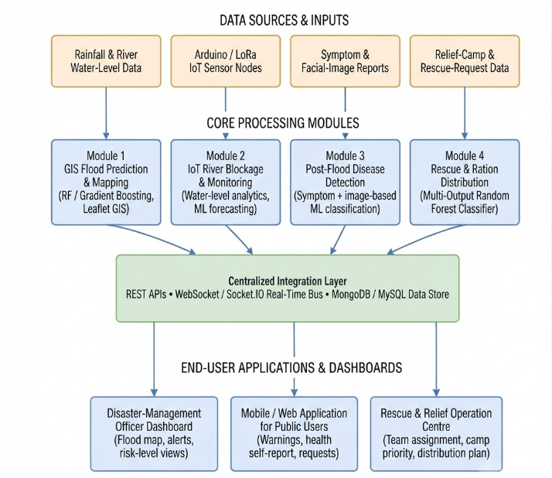
Modules publish to one shared layer
SYSTEM ARCHITECTURE
Each module ingests its own data: rainfall, IoT telemetry, symptoms and images, camp data
Outputs go to REST APIs, a Socket.IO real-time bus and MongoDB
Officers, the public app and the rescue centre all read and write the same layer
ML models run as independent microservices
FloodGuard360 · IT4010 Final Presentation
5
Notes:
Walk through Fig. 1 left to right: data sources, modules, integration layer, users. Key point: a Module 2 blockage alert is immediately visible on the Module 1 dashboard. Models are microservices, so one can be retrained without touching the others.

Slide 6
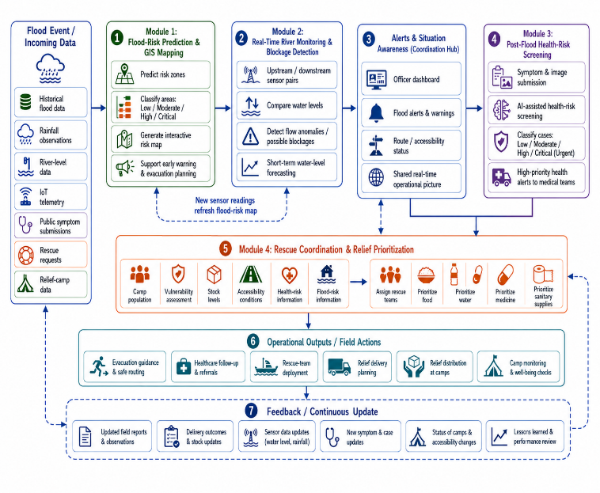
Information flows across modules
WORKFLOW DURING A FLOOD
New river-level data updates the Module 1 risk map
Module 2 flags unsafe routes before rescue teams are sent
Module 3 health risk supports medical prioritisation
No manual re-entry between modules
FloodGuard360 · IT4010 Final Presentation
6
Notes:
Fig. 2 is the operational counterpart of Fig. 1: how the modules cooperate in a real event, from first risk prediction to relief-camp distribution planning. Integration testing confirmed outputs from one module are consumed by another without manual re-entry.

Slide 7
AI, IoT and GIS on a MERN-style stack
TECHNOLOGIES APPLIED
Layer | Technology | Pillar
Frontend and mapping | React, TypeScript, Tailwind, Vite, Leaflet, GeoJSON | GIS
Backend APIs | Node.js, Express, Socket.IO | Integration
ML services | Python, scikit-learn, Random Forest, Gradient Boosting | AI
IoT layer | Arduino, 3 ultrasonic sensors, rainfall sensor, Wi-Fi | IoT
Data storage | MongoDB | Shared store
Security | JWT, bcrypt, role-based access | Security
FloodGuard360 · IT4010 Final Presentation
7
Notes:
Show depth of knowledge: why each technology. Random Forest for non-linear flood factors; Gradient Boosting for risk and water-level forecasting; Leaflet and GeoJSON for the live map; Socket.IO for time-critical alerts; MongoDB as one shared store. Roles: public, disaster officer, healthcare officer, rescue team.

Slide 8
Risk classes on a live GIS map
MODULE 1 · FLOOD-RISK PREDICTION
Inputs: rainfall, river level, elevation, land use, drainage, soil
Models: Random Forest, Gradient Boosting, Logistic Regression baseline
Output: Low, Moderate, High or Critical per location
GeoJSON layer on a Leaflet map, refreshed as new data arrive
Model | Acc. | F1 | AUC
Random Forest | 1.00 | 1.00 | 1.00
Gradient Boosting | 1.00 | 1.00 | 1.00
Logistic Regression | 0.93 | 0.91 | 0.95
Small test set (n = 40): read with caution. Larger, more diverse data is planned.
FloodGuard360 · IT4010 Final Presentation
8
Notes:
Be upfront about the 1.00 scores: the test set is only 40 records, so we do not claim perfect generalisation. The trend matches prior ensemble-learning studies, and larger Sri Lankan datasets are the next step. The main design point is that the map updates as monitoring data arrive, unlike a static susceptibility map. Expect a Q&A question on this.

Slide 9
Comparing sensors finds blockages, not just high water
MODULE 2 · DRAINAGE MONITORING
Ultrasonic sensors upstream, middle and downstream, plus a rainfall sensor
Level difference between neighbouring points, judged by size and persistence
Rainfall and tributary inflow considered to cut false alerts
Five alert levels, from Normal to Critical blockage warning
94%
0.15 m
47 of 50 anomalies detected
Forecast RMSE
0.10 m
3 / 2
Forecast MAE
False positives / false negatives
FloodGuard360 · IT4010 Final Presentation
9
Notes:
Key novelty: many IoT systems use a single sensor and a fixed threshold, which cannot tell a blockage from heavy rain. We compare water level across upstream, middle and downstream points: WL difference = WL(upstream) minus WL(neighbouring). Alerts: Normal, Low-risk anomaly, Medium-risk possible blockage, High-risk possible blockage, Critical blockage warning (verification requested). Alerts go to Module 1 (risk map refresh) and Module 4 (route accessibility). Demo or photo of the Arduino node can be added here: [hardware photo].

Slide 10
Triage that rarely misses an urgent case
MODULE 3 · POST-FLOOD HEALTH SCREENING
Inputs: age group, symptoms, duration and an optional image
Hybrid approach: ML output plus predefined risk rules
Four categories: Low, Moderate, High, Critical/Urgent
High and Critical cases are highlighted on the healthcare dashboard
Supports screening only, never independent diagnosis
Category | Prec. | Recall | F1
Low | 0.95 | 0.96 | 0.95
Moderate | 0.90 | 0.89 | 0.89
High | 0.89 | 0.92 | 0.90
Critical/Urgent | 0.93 | 0.97 | 0.95
Overall F1 0.92. Recall 0.97 for Critical/Urgent.
FloodGuard360 · IT4010 Final Presentation
10
Notes:
Why recall matters most: missing an urgent case is worse than an over-cautious flag. That is why the rules back up the ML model when confidence is low. Image preprocessing can use U-Net segmentation where needed. This module prioritises individuals for review; it does not diagnose. Data governance for health data is part of future work.

Slide 11
One model, five priority outputs
MODULE 4 · RESCUE AND RELIEF
Public users submit rescue, food, water, medical and shelter requests
Camp records: population, vulnerable groups, stock, capacity, access, time since delivery
Multi-Output Random Forest predicts overall and per-resource priority
Officers review results against Sphere minimum standards before allocating
Module 2 flags unsafe routes before dispatch
Output | Acc. | F1
Overall camp priority | 0.92 | 0.92
Food | 0.95 | 0.95
Water | 0.96 | 0.96
Medicine | 0.94 | 0.94
Sanitary supplies | 0.93 | 0.93
FloodGuard360 · IT4010 Final Presentation
11
Notes:
A single camp record needs several priorities at once, so a Multi-Output Random Forest predicts overall priority and food, water, medicine and sanitary priority together. Water is best (F1 0.96), overall camp priority lowest (0.92). The model supports officers; humans finalise allocation, and delivery outcomes are logged for future evaluation.

Slide 12

Every module meets its own measure
RESULTS SUMMARY
Module | Method | Result
Flood-risk prediction | Random Forest, Gradient Boosting | Accuracy and F1 1.00
Drainage monitoring | Ultrasonic + Gradient Boosting | RMSE 0.15 m, 94% detected
Health screening | Rules + ML | Overall F1 0.92
Rescue and relief | Multi-Output Random Forest | F1 0.92 to 0.96
Integration test passed: outputs move between modules without manual re-entry
FloodGuard360 · IT4010 Final Presentation
12
Notes:
This is the proof of concept slide: the prototype works as functional units and as an integrated system. Be honest about limits: results come from module-level evaluation on available data, and reliability depends on data quality and quantity; field validation with larger Sri Lanka-specific datasets and real sensor deployments is still required.

Slide 13



Built to be trusted in an emergency
STANDARDS, ETHICS AND QUALITY
Ethical and social
Security and privacy
Non-functional
Sphere Handbook minimum standards guide relief
Humans make the final allocation decision
Health module screens, never diagnoses
JWT authentication, bcrypt hashing
Roles: public, disaster officer, healthcare officer, rescue team
Health data governance planned
Real-time alerts through Socket.IO
Stateless ML microservices scale and retrain independently
New sensors, camps and roles added without redesign
FloodGuard360 · IT4010 Final Presentation
13
Notes:
This slide covers the mark sheet items on standards and best practice, professional, legal, social, security and ethical issues, and non-functional requirements. Mention data protection for health records and that real deployment needs proper governance.

Slide 14



From prototype to a deployable product
COMMERCIAL POTENTIAL
Who needs it
Why it stands out
Proposed model
Disaster-management officers
Healthcare officers
Rescue teams and relief operations
Local authorities in flood-prone areas
One platform instead of four separate tools
Low-cost Arduino sensor nodes
Modules can be adopted one at a time
Sri Lanka-focused retraining
Platform licence or subscription [price]
Sensor-node supply and installation [cost per node]
Training, support and maintenance [terms]
Next step: pilot deployments with real sensors and operational records before large-scale rollout.
FloodGuard360 · IT4010 Final Presentation
14
Notes:
This slide carries 20% of the marks (commercialization and entrepreneurship), so rehearse it. Users and strengths come from the paper. The revenue model and the bracketed figures are proposals for the team to confirm: add your real cost per sensor node, pricing and any market numbers you have evidence for. Do not quote figures you cannot back up. Mention any named partner or pilot site only if it is real: [pilot site].

Slide 15
What we will do before large-scale use
LIMITATIONS AND FUTURE WORK
Current limits
Next steps
Small flood-prediction test set (n = 40)
Reliability depends on data quality and quantity
Needs field validation with real sensors and records
Collect Sri Lanka-specific datasets
Pilot IoT deployments
Evaluate health screening under data governance
Test relief prioritisation on operational records
Offline and edge processing, extra alert channels for low-connectivity areas
FloodGuard360 · IT4010 Final Presentation
15
Notes:
Showing limits honestly earns credibility with examiners. Human oversight and Sphere minimum standards stay central to the decision-support process as the system matures.

Slide 16
Connected flood management, from prediction to relief
CONCLUSION
Four modules, one shared layer: faster awareness, earlier response and fairer resource allocation.
Thank you. Questions?
Notes:
Close with the central contribution: the coordinated exchange of information across the disaster-management workflow rather than four isolated tools. Invite questions and keep answers short. Likely questions: why 1.00 accuracy, how false alerts are reduced, data privacy, cost of deployment.

